Slide 1
Expanding Research Collaboration in ATE Projects: Two Case Studies Anchored in Improving Manufacturing Student Success
Presenters:
Xueli Wang and L. Allen Phelps, UW-Madison
Laura Waurio, Fox Valley Technical College
Lawrence Gross, Milwaukee Area Technical College
This material is based upon work supported by a grant from the National Science Foundation (Award no. 1104226). Any opinions, findings, and conclusions or recommendations expressed in this material are those of the author and do not necessarily reflect the views of the National Science Foundation

Slide 2
Session Overview
The METTE Project
Student Success Model
Research and Innovation Framework
Case Study 1: FVTC Dual Credit Partnerships
The Evidence
Strategies for Improving Student Success
Career Jump Start High Schools
Appleton West Technical Academy
Case Study 2: MATC Contextualized Remedial Math
Innovation: Reinventing remedial math through contextualization
Research: Longitudinal mixed-methods design to study impact on student success
Notes:
(5-8 minutes)
Brief, self introductions
Patti to develop additional slides and slides
Invite the Audience to Identify 2-3 significant “knowledge gaps”

Slide 3
Improving Educational Outcomes in Manufacturing Engineering Technologist and Technician Education
Research and Innovation Partnership to Improve Student Success
Five Partners: UW-Madison, FVTC, MATC-Milwaukee, MPTC, and WCTC
Student Success Model
Research and Innovation Framework
Notes:
offer 35 of Wisconsin’s METTE 54 associate degree and technical diploma programs. Annually, METTE programs at these four colleges serve more than 3,000 students or about 40% of METTE program enrollees in Wisconsin’s technical colleges.

Slide 4
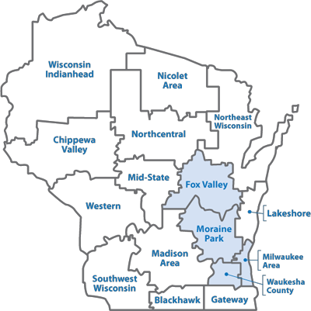
Notes:
Manufacturing is the largest industry sector in WI’s economy, employing near
These four colleges offer 35 of Wisconsin’s METTE 54 associate degree and technical diploma programs. Annually, METTE programs at these four colleges serve more than 3,000 students or about 40% of METTE program enrollees in Wisconsin’s technical colleges.

Slide 5
Two Guiding Questions:
What are the specific METTE program features that are associated with optimal student outcomes?
How can key METTE stakeholders use research data and findings to inform strategic program improvement decisions?

Slide 6
METTE Student Success Model
Notes:
Initial Model in our proposal based on student development ( ) and social-cognitive career theory (Lent, Brown and Hackett)
Model has changed from our collaborations: (a) WTCS mission is predominately workforce development, so LM outcomes are getting more attention, (b) college and career readiness, common core curriculum, and importance of precollege experiences led to modifications in the HS factors we are studying.

Slide 7
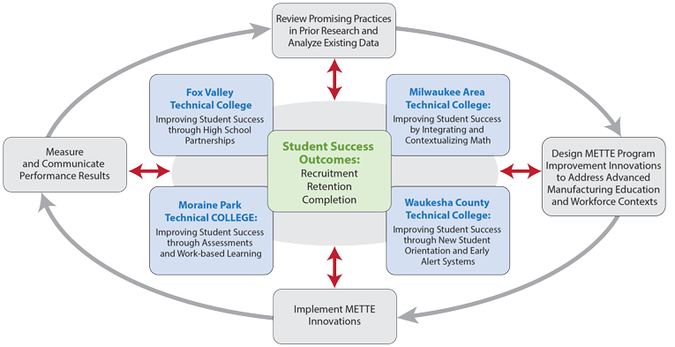
Research and Innovation Framework
Local Leadership Team
V-P for Instruction
MFG &ENGR Dean
Institutional Research Office
UW Mad Researcher
Networked Improvement Communities
Local Leadership Team
Associate Deans
Faculty Leaders
Inst. Research Analysts

Slide 8
Fox Valley
Technical College
Improving Student Success
Through High School Partnerships
Student Success Outcomes:
Recruitment
Retention
Completion
Research Questions
In what ways do school-level and student-level characteristics influence students’ early success at FVTC?
Which has greater influence: school-level or student-level characteristics?

Slide 9
Key Research Findings

Slide 10
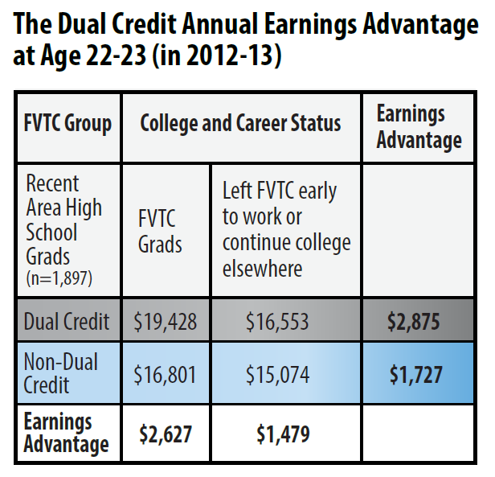

Slide 11
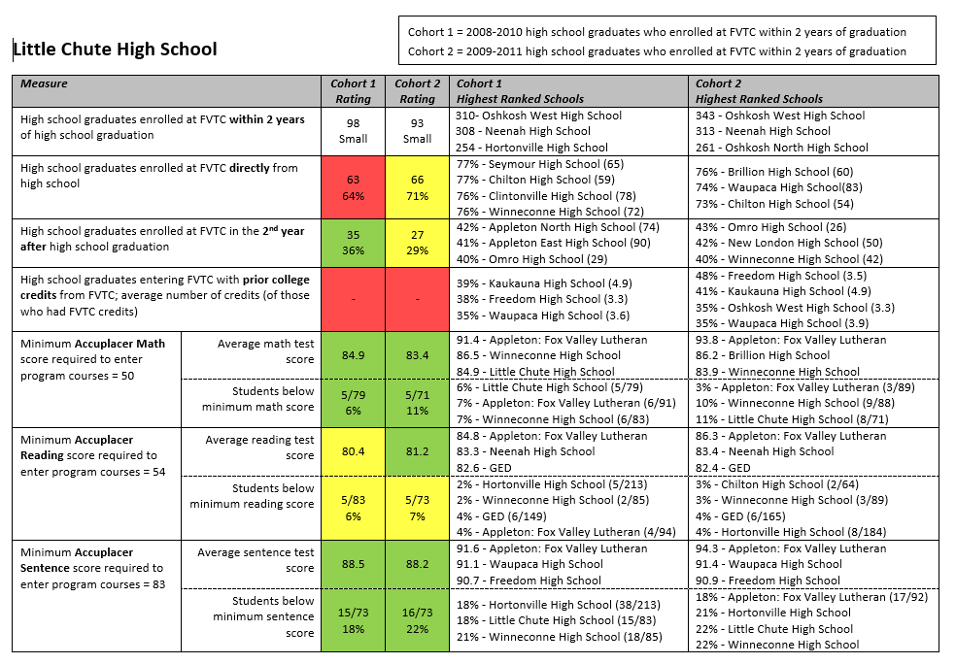
Notes:
Data sharing with local high schools: summer summits held at FVTC for Machine Tool (June 2014) and Electronics (July 2014)

Slide 12
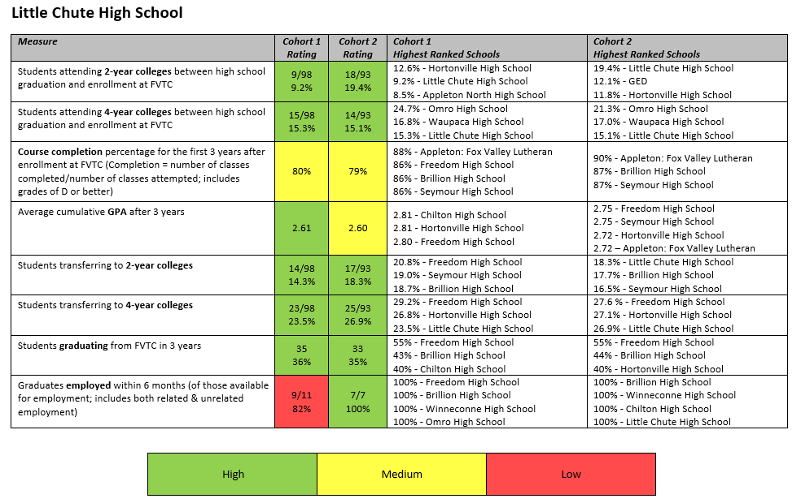

Slide 13
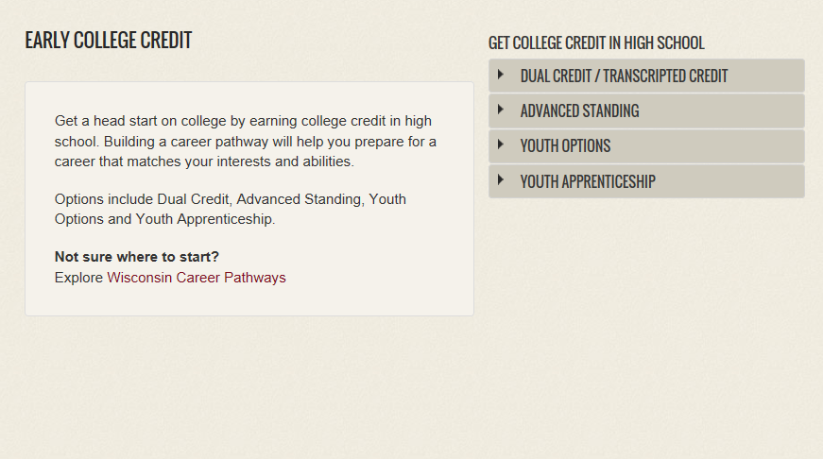
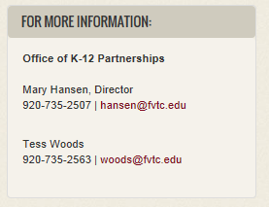
Dual-credit Recruitment
http://www.fvtc.edu/parents-family/why-fvtc/early-college-credit
Course offerings by school

Slide 16
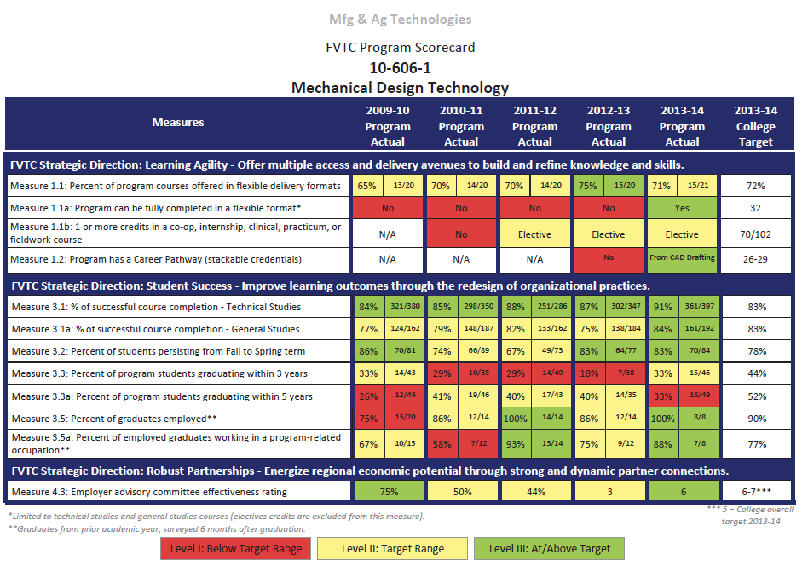

Slide 17
Employer Advisory Committees
Advisory Committee Effectiveness Scorecard Measures:
Committee includes a minimum of 10 Business Representatives.
Committee meets a minimum of 2 times per academic year.
Committee membership is reviewed on an annual basis to assure appropriate industry representation.
Committee provides feedback on industry trends at least once per academic year.
Committee reviews program outcomes once per academic year.
Committee members support the program through activities and initiatives outside of the scheduled advisory committee meetings.
Committee participation (attendance) rating. Goal is to maintain 50-60% participation.

Slide 18
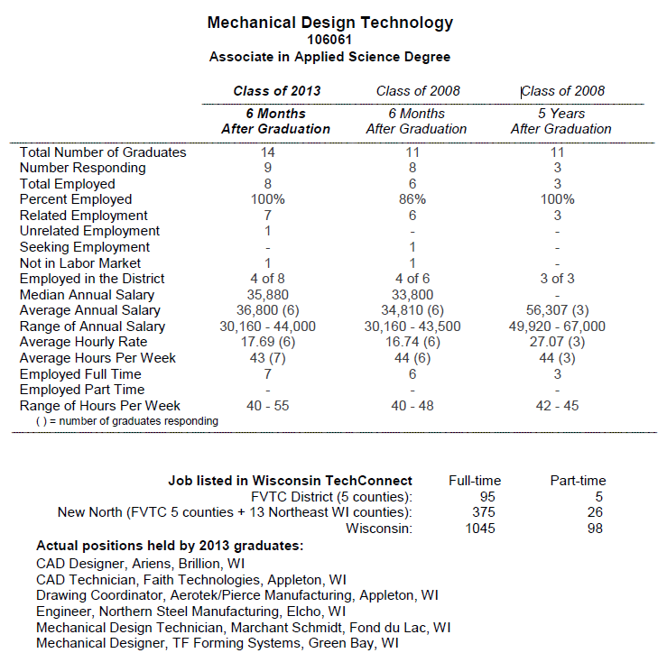
http://www.fvtc.edu/our-grads-get-jobs

Slide 22
Case 2: Contextualized Remedial Math Offerings in METTE programs at MATC
Contextualized instruction, also referred to as contextualized teaching and learning (CTL), is “a diverse family of instructional strategies designed to more seamlessly link the learning of foundational skills and academic or occupational content by focusing teaching and learning squarely on concrete applications in a specific context that is of interest to the student” (Mazzeo, 2008, p. 3).

Slide 24
System/meaning
Context
Units of measure
definition

Slide 25
jaberwocky
`Twas brillig, and the slithy toves
Did gyre and gimble in the wabe:
All mimsy were the borogoves,
And the mome raths outgrabe.

Slide 26
jaberwocky
`Twas brillig, and the slithy toves
Did gyre and gimble in the wabe:
All mimsy were the borogoves,
And the mome raths outgrabe.
follows the rules of grammar
Has no real meaning

Slide 27
36 4 9

Slide 28
36 ÷ 4 = 9
Follows all the rules of math
Has no real meaning

Slide 29
36 ÷ 4 = 9
3 dozen eggs yield how many
4 egg omelettes

Slide 30
The contextualized math remedial curriculum
Developed for students aspiring to enroll in manufacturing and engineering programs but in need of remedial math

Slide 31
The contextualized math remedial curriculum
Developed for students aspiring to enroll in manufacturing and engineering programs but in need of remedial math
Developed by faculty from Mechanical Design and Welding Technology with input from Electronics

Slide 32
The contextualized math remedial curriculum
Developed for students aspiring to enroll in manufacturing and engineering programs but in need of remedial math
Developed by faculty from Mechanical Design and Welding Technology with input from Electronics
The basis of instruction was to trail the curriculum of the traditional GenMath 110, reinforcing the purpose of math use

Slide 33
The contextualized math remedial curriculum
Developed for students aspiring to enroll in manufacturing and engineering programs but in need of remedial math
Developed by faculty from Mechanical Design and Welding Technology with input from Electronics
The basis of instruction was to trail the curriculum of the traditional GenMath 110, reinforcing the purpose of math use
Problem solving exercises from electronics, mechanics, welding and general areas were used

Slide 34
The contextualized math remedial curriculum
Developed for students aspiring to enroll in manufacturing and engineering programs but in need of remedial math
Developed by faculty from Mechanical Design and Welding Technology with input from Electronics
The basis of instruction was to trail the curriculum of the traditional GenMath 110, reinforcing the purpose of math use
Problem solving exercises from electronics, mechanics, welding and general areas were used
Direct measurement was used for some data

Slide 35
Examples
Developing a formula for converting Fahrenheit temperature to Celsius

Slide 36
Examples
Developing a formula for converting Fahrenheit temperature to Celsius
Graphing slope & intercept and comparing it to Tensile testing where the modulus of elasticity is charted to reveal the yield point or elastic limit.

Slide 37
Examples
Developing a formula for converting Fahrenheit temperature to Celsius
Graphing slope & intercept and comparing it to Tensile testing where the modulus of elasticity is charted to reveal the yield point or elastic limit.
The idea of replacing formula generated numbers with physical measurements to generate the formula based on change in force and change in length.

Slide 38
Design of the study
Question: How do students’ experiences within contextualized remedial math classes influence their motivational beliefs about their math abilities and future college success?

Slide 39
Design of the study
Question: How do students’ experiences within contextualized remedial math classes influence their motivational beliefs about their math abilities and future college success?
A multistage mixed methods research design
Stage 1 (Fall 2013)—classroom observations of two pilot contextualized remedial math classes and semi-structured interviews with six students and two instructors

Slide 40
Design of the study
Question: How do students’ experiences within contextualized remedial math classes influence their motivational beliefs about their math abilities and future college success?
A multistage mixed methods research design
Stage 1 (Fall 2013)—classroom observations of two pilot contextualized remedial math classes and semi-structured interviews with six students and two instructors
Stage 2 (Spring 2014)—new survey data from all 27 students enrolled in three contextualized remedial math classes.

Slide 41
Design of the study
Question: How do students’ experiences within contextualized remedial math classes influence their motivational beliefs about their math abilities and future college success?
A multistage mixed methods research design
Stage 1 (Fall 2013)—classroom observations of two pilot contextualized remedial math classes and semi-structured interviews with six students and two instructors
Stage 2 (Spring 2014)—new survey data from all 27 students enrolled in three contextualized remedial math classes.
Stage 3 (Spring 2014-ongoing), follow-up interviews with six students from survey participants and five instructors to deepen and contextualize findings from the survey data.

Slide 42
Summary of Findings—Stage 1 Class Observation

Slide 43
Summary of Findings—Stage 2 Survey

Slide 44
Summary of Findings—Stage 3 Interviews
Math contextualization as a game changer—from fear to fearless
“Instructor showed us how math skills can be applied to the work field, which I thought was tremendous. It created a better involvement for the class… Getting into a program like that offered me the opportunity that I got the ball rolling. I want to keep it going. Like the possibilities are endless to whatever the direction I want to go. I am more motivated to take more classes, to be more participated in the class. … I was more willing to throw my feet into the field and say “now you got to do this”. I was able to this, so it kind of pushed me to do more things, and not being so intimidated or afraid of having too many responsibilities.”

Slide 45
Summary of Findings—Stage 3 Interviews
Instructor as the change agent in contextualization
“You have to be approachable as an instructor because if you’re not, then the students have some… ’how should I put this?’ They’re not comfortable talking to you, that’s just simple. They’re not comfortable coming up to you. They’re not comfortable in the class, asking you questions and ultimately, you know what that happens? I mean, you know what happens after that? They drop out.”
“We kind of did like welding basics and fundamental kind of one-on-one, …. Whereas if I didn’t do that and wanted to jump into that program and not had that, I would jumped off the side of the pool and drown. You know…where now I kind of have a little bit of help, a little bit of assistance where I kind of know how to stay above the water.”

Slide 46
Sustainability of Innovation and Research Projects
On-going math contextualization in remedial offerings in METTE

Slide 47
Sustainability of Innovation and Research Projects
On-going math contextualization in remedial offerings in METTE
On-going data collection and analysis to inform practice

Slide 48
Sustainability of Innovation and Research Projects
On-going math contextualization in remedial offerings in METTE
On-going data collection and analysis to inform practice
Instructor professional development in both teaching and data analysis

Slide 49
Sustainability of Innovation and Research Projects
On-going math contextualization in remedial offerings in METTE
On-going data collection and analysis to inform practice
Instructor professional development in both teaching and data analysis
Tap into other existing resources/personnel to amplify contextualization’s positive impact:
Faculty collaboration
Peer learning and support
Tutoring and other on-campus services (e.g., Women in Technology Center)
Institutional research and assessment

Slide 50
WEB-BASED RESOURCES FOR ATE Centers and Projects
METTE http://mette.wceruw.org/
Evidence-Based Innovations, Tools, and Studies
CCSSE http://www.ccsse.org/center/
Policydirect.org http://www.policydirect.org/
AtD-Intrv Shwce http://achievingthedream.org/resources/ achieving-the-dream-interventions-showcase
OCCRL http://occrl.illinois.edu/
NRCCTE http://www.nrccte.org/
Teaching Technicians – Proven and Promising Practices
https://www.teachingtechnicians.org/Resources/PPP/
CAPSEE http://capseecenter.org/
NCPR http://www.postsecondaryresearch.org/

Slide 51
Discussion Questions
What do we know about early college success factors such as the benefit of dual credit and contextualization in remedial math?
Guided by research evidence, what are some of the promising practices to deepen their benefit?
What are the challenges, limitations, and lessons learned in studying the complex array of factors that influencing two-year technical college student success?

